Slide 1
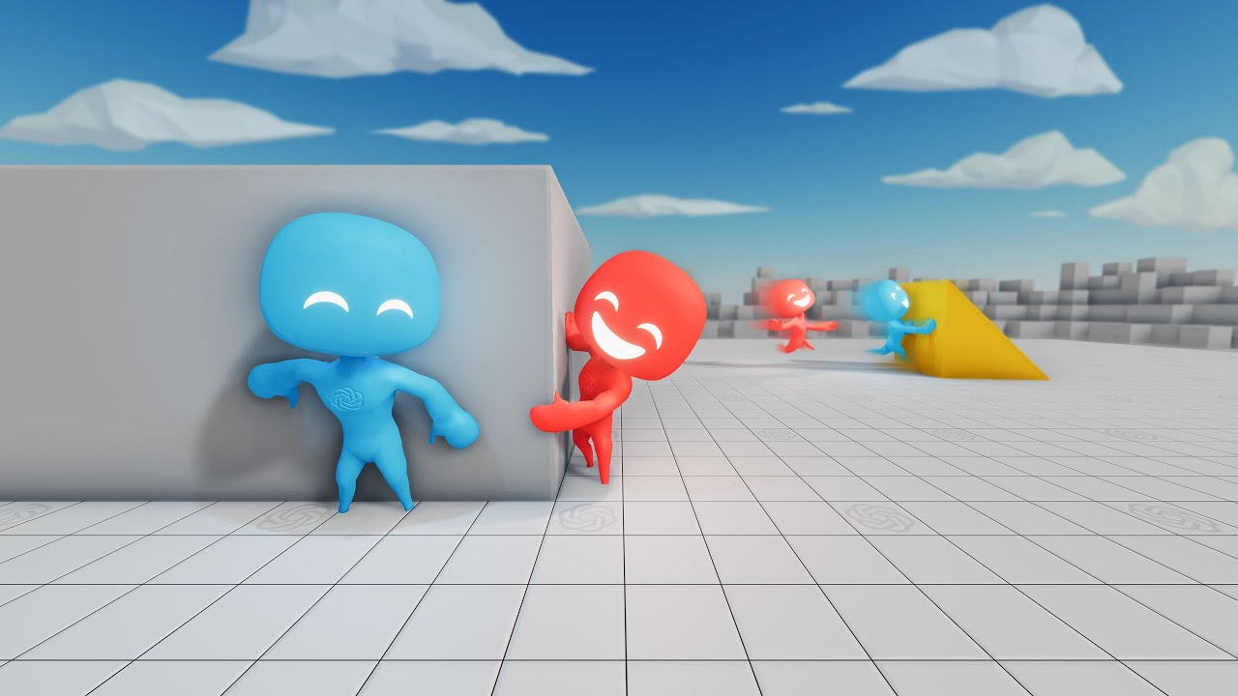
Multiagent Parallel Distributed A*
Tom Eliassy
Supervisor: Professor Jeff Rosenschein
The Hebrew University of Jerusalem
Benin School of Computer Science and Engineering
67537 - Tutorial Work
2019

Slide 2
Background
01
Multiagent Parallel Distributed A*
Optimizations
02
04
Technical Aspects
Overview
Observations
03
05
06
Conclusions
07
References
Introduction, Related Work, Platform, Motivation
Description, Algorithm, Free Flow Specification
Dead-ends Detection, Stranded Colors and Regions, Chokepoints Detection, Fast-forwarding
Flow Diagram, High-level UML,Modules
Experimental Measurements, Findings

Slide 3
01
Background
Introduction, Related Work, Platform, Motivation

Slide 4

Introduction
Supporting Re-planning using A* technique
Interaction between some Agents
Finding solution based on component division (projection)
Respecting prioritization and constraints
Based grid problem
Offline calculating

Slide 5

Related Work
Multi-Agent A* for Parallel and Distributed Systems (Nisim & Brafman): The ancestor work that our project is derived from (The generalized version)-
Deals with Parallel Distributed MA-A* in terms of Search problem (Successors, Expansion, Heuristic…).
Generic algorithm which can be adapted to a variety of problems.
Agents’ communication (by signaling).
Consideration of accessing to private and shared information.
Distinction between private actions to public ones (existence of pre-conditions for the last actions).
Reducing to a single A* Agent possibility.
Trade-off: Limited computing power Vs. Information access.

Slide 6
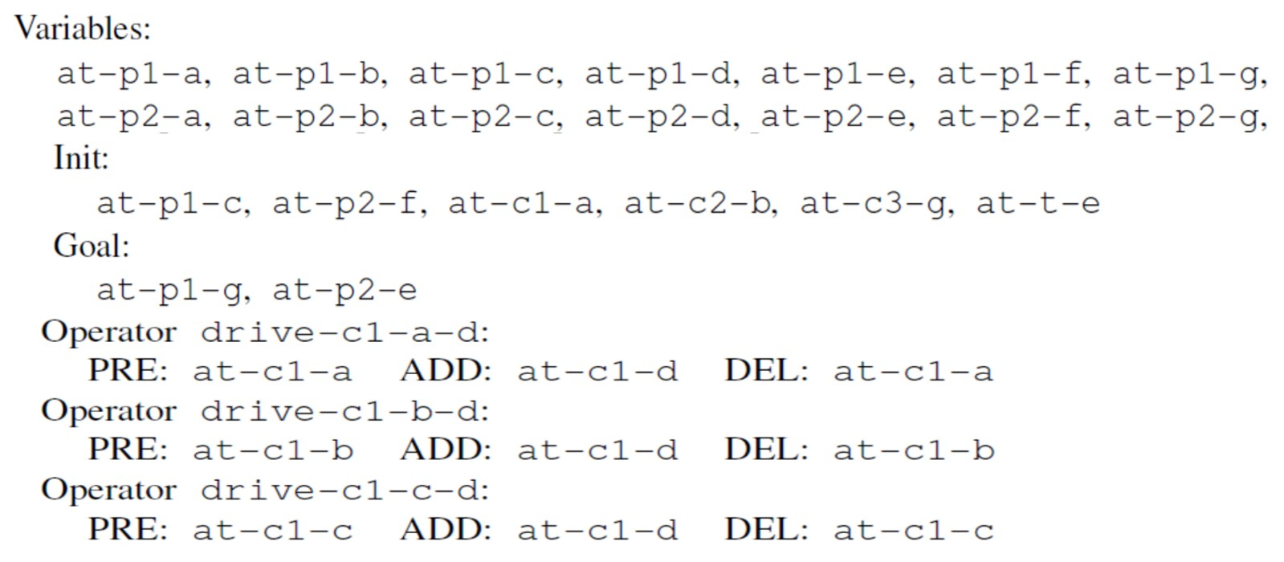
Related Work
2. From One to Many: Planning for Loosely Coupled Multi-Agent Systems (Domshlak & Brafman): Constraint Satisfaction Problem (CSP) for low coordination cases-
Loosely coupled assumption (requires less coordination)
Deals with measurements of 2 parameters: Problem Independent (measures the the system’s coupling level) and Problem Specific(The min. number and the max. number of actions required from an agent to solve the problem).
Using Constraint Satisfaction Problem (CSP) technique and formulation(STRIPS) with respect to the time dimension.
Focus on the worst - case time complexity.
Using “agent interaction graph”- Two agents are connected if one agent’s action affects the functionality of the other agent (proportionate to the time complexity).
Some problems can’t be solved due to the required level of coordination.
Defines internal actions, public actions as well as coordination points.

Slide 7
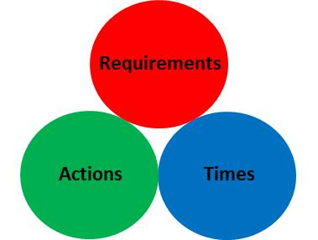
Related Work
3. A General, Fully Distributed Multi-agent Planning Algorithm (Nissim, Brafman and Domshlak): Constraint Satisfaction Problem (CSP) Heuristic based. Adapted to the Multi-Agent concept -
Loosely coupled, limited agent interaction: Some problems can’t be solved due to the required level of coordination.
Combines local planning as well as coordination between agents. Defines internal actions, public actions and coordination points. Looking for a global and local consistency.
Using Constraint Satisfaction Problem (CSP) technique and formulation
adapted for some agents(MA-STRIPS) with respect to the time dimension.
Respects the “Forced (essential)-Moves” concept by a global manner.
Other agents’ planning as a “black-box”. Don’t match to a centralized planner, improves centralized solutions.
Splitting the aspects of an agent planning among 3 variables: (public) Actions, Time(s) and Requirements.
Uses Heuristic that dynamically selects an agent: based on most-constrained (first) and goal-achieving(#achievable sub-goals) concepts. (rather than Min-Domain variable Ordering heuristic that requires fully generated domains).
h. The “agent interaction graph”- determines how loosely-coupled the problem is.
i. There is an upper bound on the number of public actions of each agent (d).

Slide 8
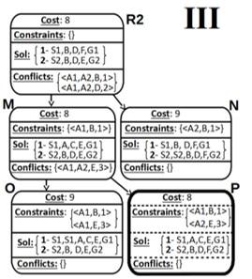
Related Work
Conflict-Based Search Algorithm for Multi-Agent Pathfinding (Boyarski et al.):
2 levels centralized search, respects constraints -
Pathfinding oriented, based on graph structure with respect to the time dimension.
Formalized as a global, single-agent search problem for centralized computing.
Allows “wait” action which is an integral part of the described algorithm.
Aims to improves the CBS by focusing on cases that it performs poorly, exponentially worse than A*.
Composed of 2 levels: 1) High-level constructs a constraint-tree (nodes contain time & locations constraints of a single agent) by finding conflicts and constraints addition. 2) Low level search which is performed at each node of the constraint-tree in order to find individual paths for all the agents considering the constraints of the corresponded high-level node (can be done by any algorithm, usually A*).
Bounds the number of allowed conflicts at the high-level phase between any pair of agents by a predefined parameter B. When exceeding B, the conflicting agents are merged into a single agent that treated by the low-level solver.
There are 3 improvements for the algorithm:
Bypass (BP)- Improves the low-level paths in some ways => reducing the CT size.
Merge & Restart (MR)- When a decision to merge is made, it is suggested to restart the search (avoiding duplicating effort for the low-level solver when calculating the path and the constraints for the merged agent B + 1 times).
Prioritizing Conflicts (PC)- Conflicts classification by 3 types: cardinal (certainly increases the solution’s cost), semi-cardinal and non-cardinal. Reducing the size of the CT regarding the type of the conflicts.

Slide 9
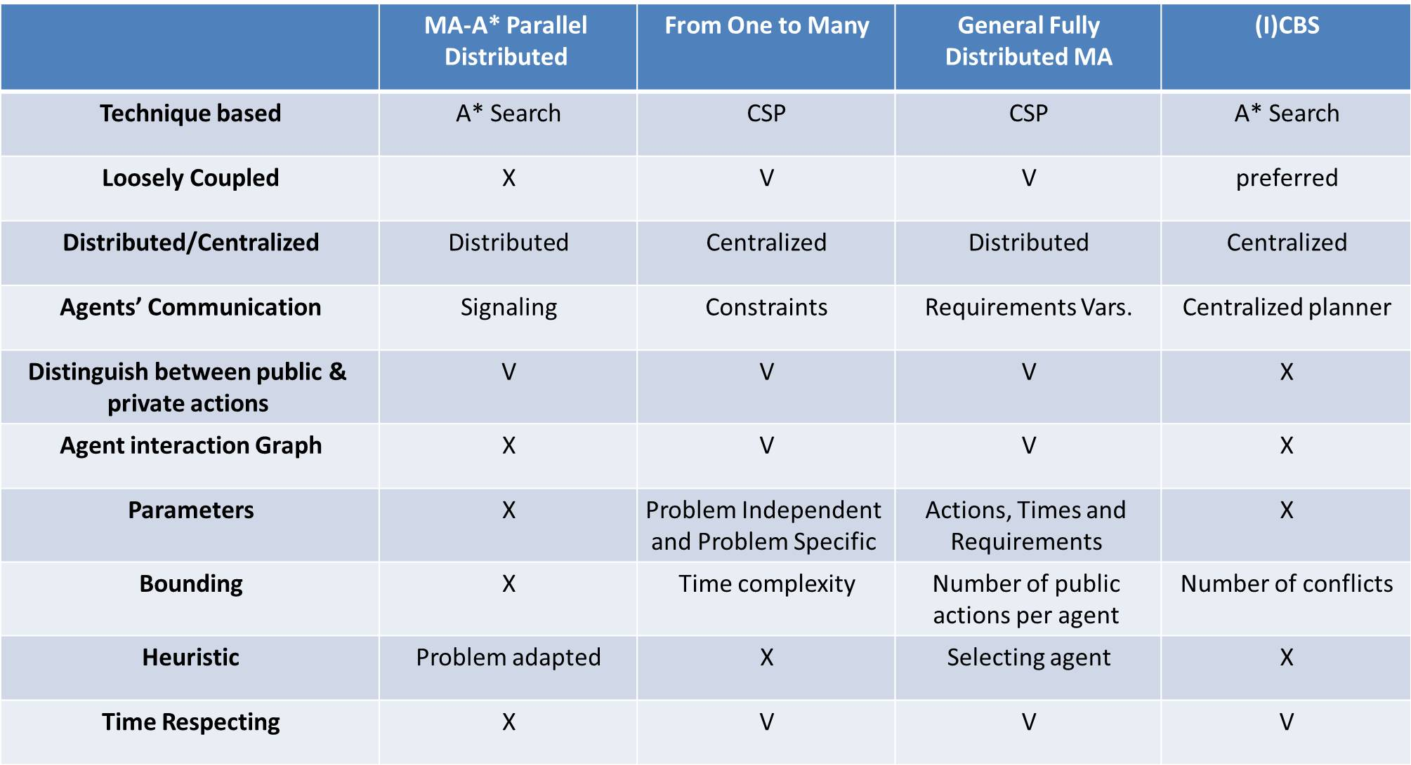
Putting all together

Slide 10
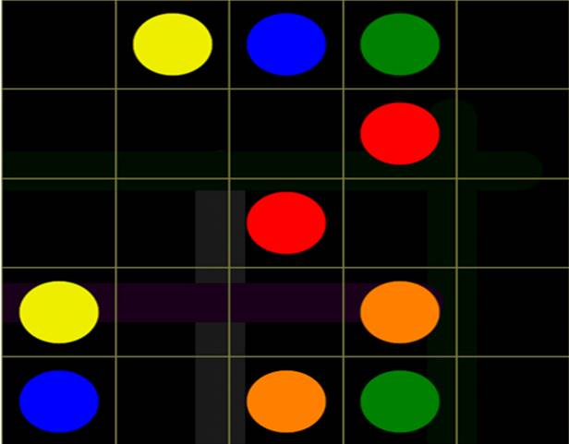
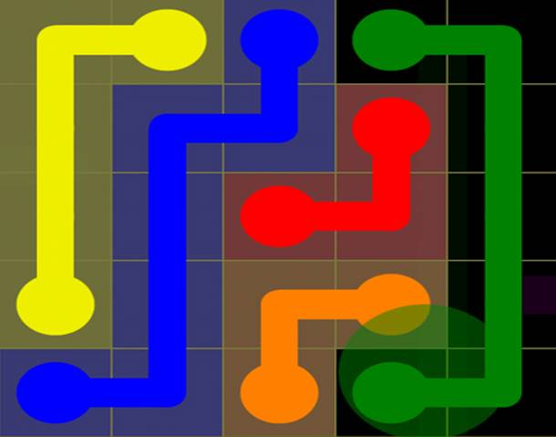
Platform
Flow Free-
A puzzle game for Android and iOS released by American studio Big Duck Games in June 2012.
The game takes place on a grid contains some couples of colored dots (the uncolored squares are considered to be empty).
The objective is to draw flows (paths) between every pair of dots with the same color such that:
All the couples of dots will be connected
All the empty squares will be filled by the flows.
The difficult level is directly affected by the squared-size of the grid, ranges from 5X5 to 14X14 cells.
There are some expansions to the game:
“Flow Free: Bridges” (November 2012)- Contains bridges that have to be occupied by a flow that will pass it above other flow (may be the same flow).
“Flow Free: Hexes” (October 2016)- Hexagon- shaped grids.
“Flow Free: Warps” (August 2017)- Different squares- shaped grids such that “entering” an edge “transports” the corresponded flow to the other-side edge by the “back” of the board.
Wikipedia: https://en.wikipedia.org/wiki/Flow_Free , YouTube: https://www.youtube.com/watch?v=nxp8Zg1gmro

Slide 11
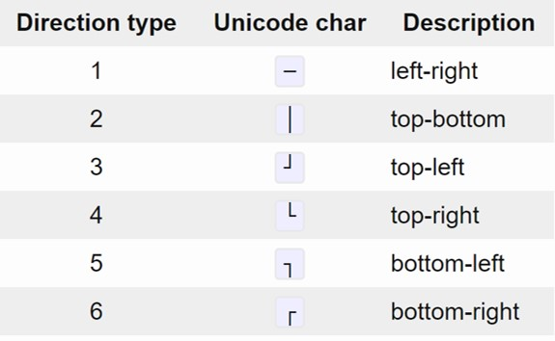
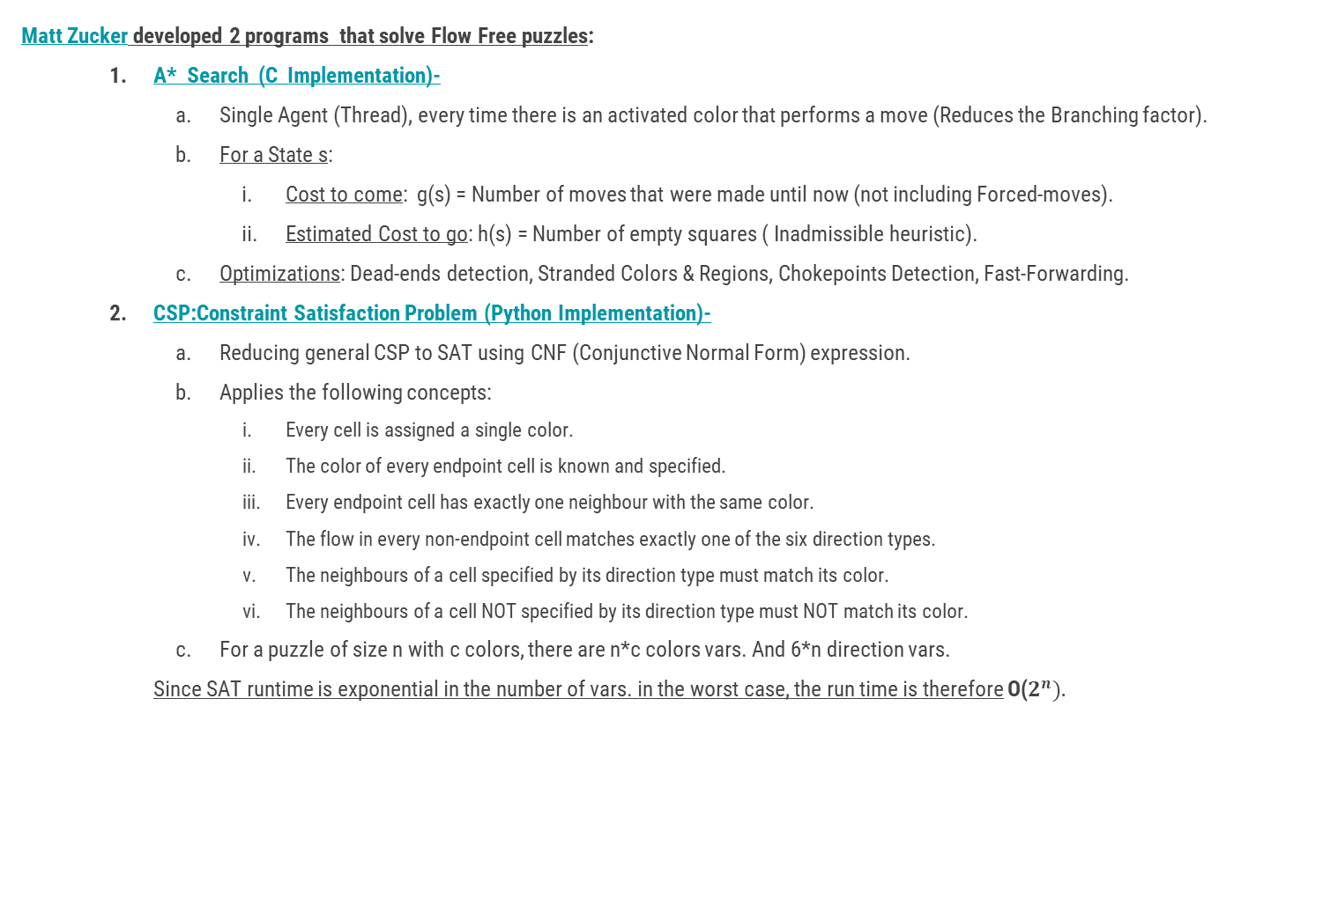
Matt Zucker’s Programs
Matt Zucker developed 2 programs that solve Flow Free puzzles:
A* Search (C Implementation)-
Single Agent (Thread), every time there is an activated color that performs a move (Reduces the Branching factor).
For a State s:
Cost to come: g(s) = Number of moves that were made until now (not including Forced-moves).
Estimated Cost to go: h(s) = Number of empty squares ( Inadmissible heuristic).
Optimizations: Dead-ends detection, Stranded Colors & Regions, Chokepoints Detection, Fast-Forwarding.
CSP:Constraint Satisfaction Problem (Python Implementation)-
Reducing general CSP to SAT using CNF (Conjunctive Normal Form) expression.
Applies the following concepts:
Every cell is assigned a single color.
The color of every endpoint cell is known and specified.
Every endpoint cell has exactly one neighbour with the same color.
The flow in every non-endpoint cell matches exactly one of the six direction types.
The neighbours of a cell specified by its direction type must match its color.
The neighbours of a cell NOT specified by its direction type must NOT match its color.
For a puzzle of size n with c colors, there are n*c colors vars. And 6*n direction vars.
Since SAT runtime is exponential in the number of vars. in the worst case, the run time is therefore O($2^{n}).$

Slide 12

Motivation
Regarding the properties of the Flow Free platform, we would like to have an appropriate planner (which is not based on CSP) that has the following features :
Tightly coupled agents are treated
It is hard to distinguish between public actions to private/internal ones.
Distributed (for supporting projections).
Bounded overhead (as a result of access to shared-resources).
Contains agents interaction(as a result of the distributing requirement).
No time adaption (since there is no meaning to “wait” action
in the Flow Free platform).
Note: There is no meaning to the optimality of the solution.

Slide 13
02
Multiagent Parallel Distributed A*
Description, Algorithm, Free Flow Specification

Slide 14
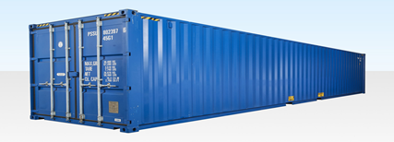
Description
Multiagent A* is a distributed variation of A* that can be done in parallel calculation. There is a shared-resource which is actually a data-structure contains information that is relevant for all the participant agents so they have to communicate each other using this data structure (may no one of them deals the whole knowledge). Because of the shared- resource use, there is a need to use a mutual- exclusion object that will limit the simultaneous access to this shared-resource only for a single agent every time. In turn, every agent may store a state that is necessary for the other agents (with specifying to which ones of them) and will also pick a relevant state that an other agent has posted for him .

Slide 15
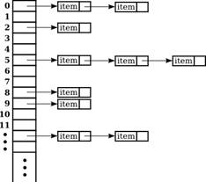
Description
In addition, every agent has a minimum priority- queue which stores the states that are candidates for expansion (so called openList). In every iteration of the A* algorithm (next slide) we’ll expand the state s with the minimum f(s) = g(s) + h(s) value (explanation in the next few slides). Alongside the openList, there is a closedList of already expanded states. Note: While giving the same state to two different agents they will generate different successors states (since each of them has his own considerations).
Expansion prioritization: First, an agent will try to expand a state taken from the shared- resource. If there is no such state, the agent will try to expand a state from his openList and in case that it is empty - the agent will go to sleep.

Slide 16
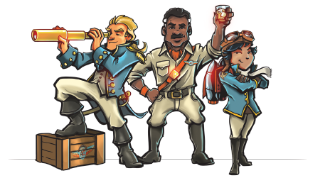
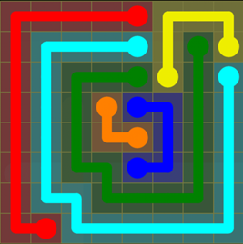
Description
Termination Detection: Occurred when an agent completes his flow while all the other agents have already executed their flows on the same state before. In such a case, the agent will notify all the other agents about the solution finding and will update the global variable that stores the solution state (which is also a shared-resource).
Notifies

Slide 17
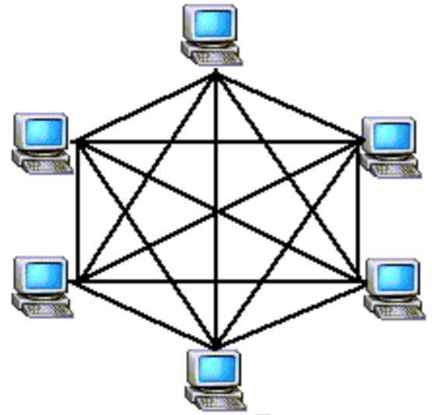
Algorithm
Multi-Agent A*:
First expansion (The shared-resource and the openList are empty, no states to get)
While (Not (global goal state)) do
Acquire the mutual-exclusion object
If (there is a relevant state in the shared-resource which hasn’t been expanded by this agent yet)
Get the state from the shared resource and expand it
Release the mutual-exclusion object
If (didn’t get a state from the shared-resource)
1. If (the openList is Not empty)
a. Get a state from the openList and expand it
Else
a. Go to sleep

Slide 18
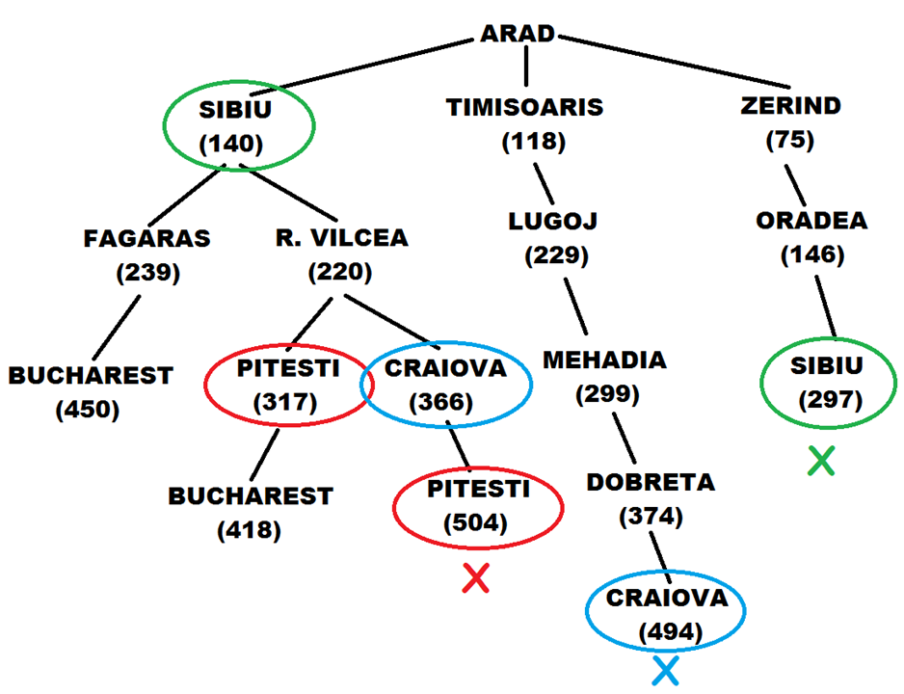
Algorithm
2.Expand (state):
Insert state to the closedList // Mark as visited
If (state is a global goal state) -> return
successors <- Find successors (state)
Each successor that is NOT in the closedList will be inserted to the openList
If (one of the successors is a local goal state) -> Post the state to the relevant agents using the shared resource
3.Find successors(state):
Optional moves <- Calculate the optional moves for the current agent
While (There is only a single optional move) do Fast-forwarding
For every move in Optional moves
If (The move has to be eliminated) -> add move to the closedList
Return Optional moves

Slide 19
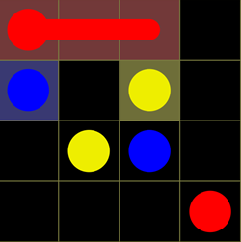
Flow Free - Problem Specification
Shared-Resource (Data Structure) Dictionary maps <Agent, min. Priority queue of pending states for agent>. The priority queue ordered regarding the f = g+h value of the pending states.
Mutual-Exclusion Object A single Semaphore, Free of deadlock and starvation.
Notifying about global goal state Using Python’s Event, function as a sleeping flag. In Python it is possible to send signals only to the main thread (https://docs.python.org/3/library/threading.html)
Prioritizing states contains complete flows of other agents By setting g_value = 0 for the state that is sent to them.
g value and h value g: #moves executed only by the current agent (not include Forced-moves).
h: #empty squares in the state
In the example taken from https://mzucker.github.io/2016/08/28/flow-solver.html: g(s) = 1, h(s) = 8

Slide 20
03
Technical Aspects
Flow Diagram, High-level UML,Modules

Slide 21
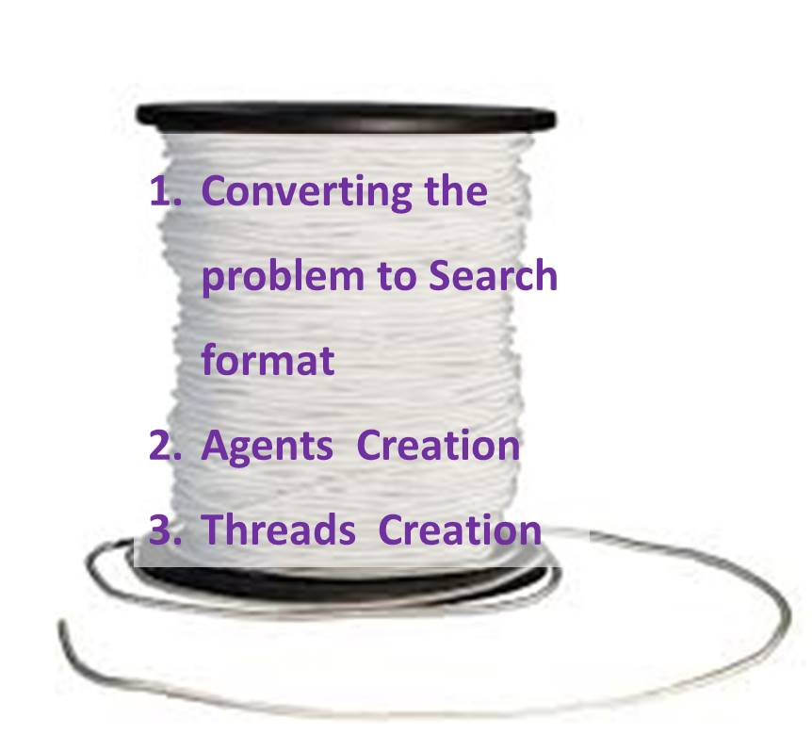
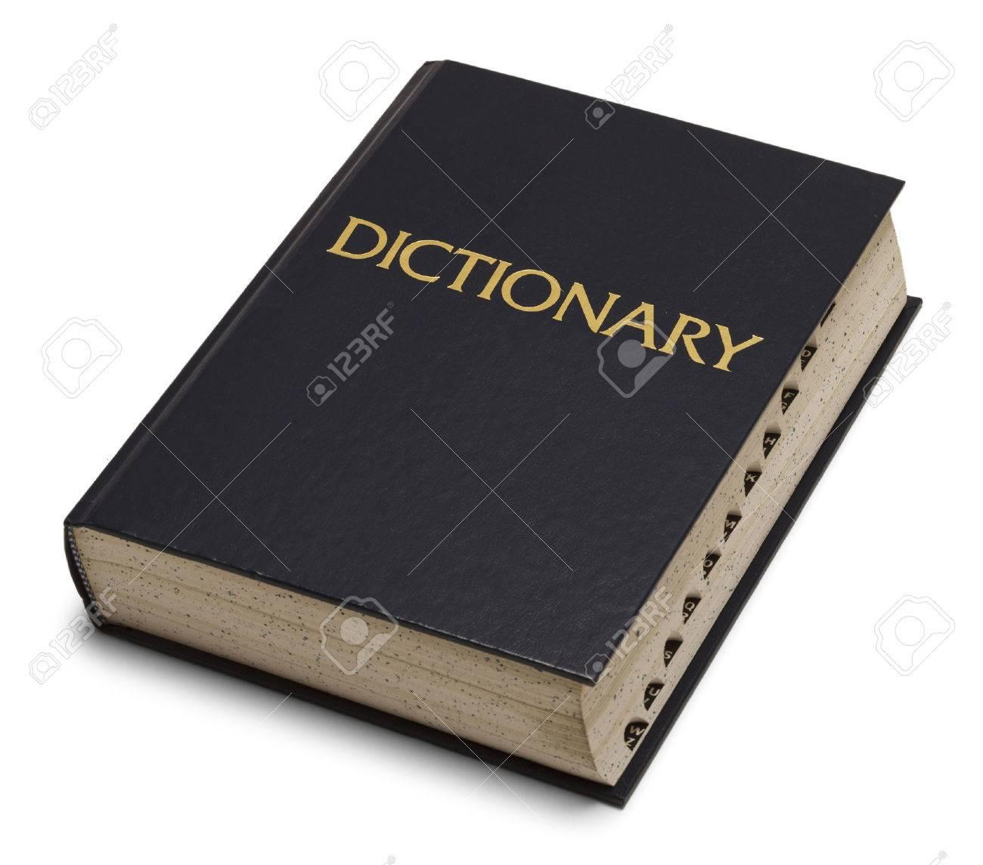
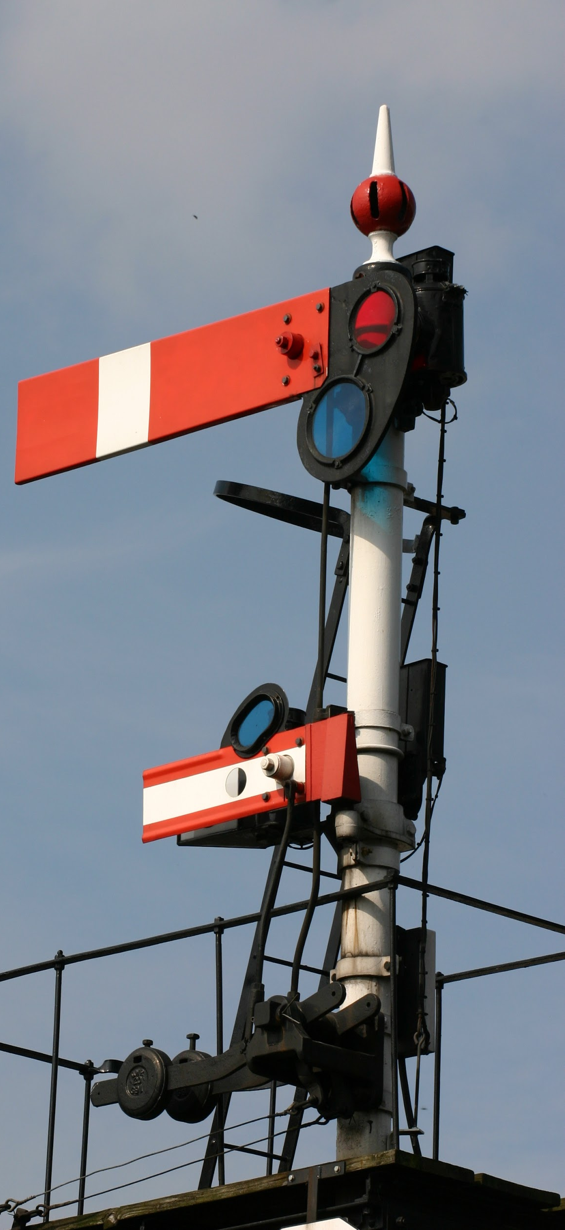
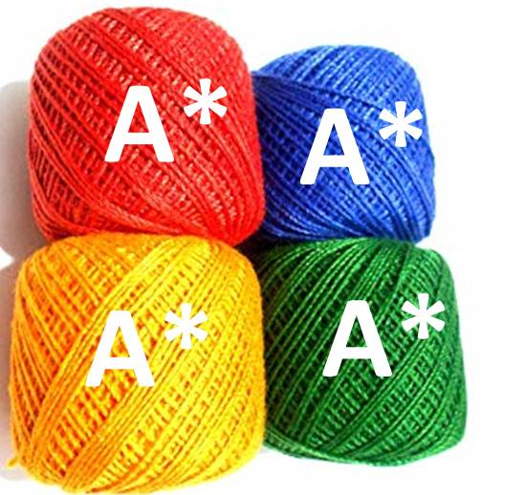
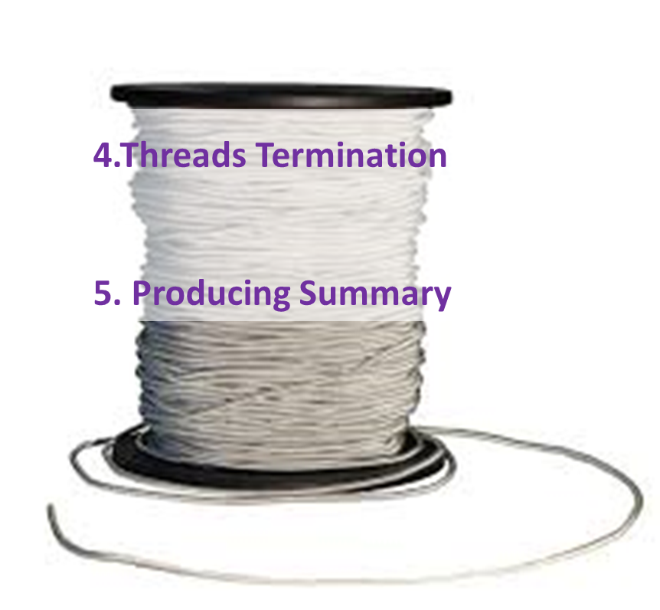
Flow - Diagram
Main Thread
Main Thread
Global Goal State has been found

Slide 22
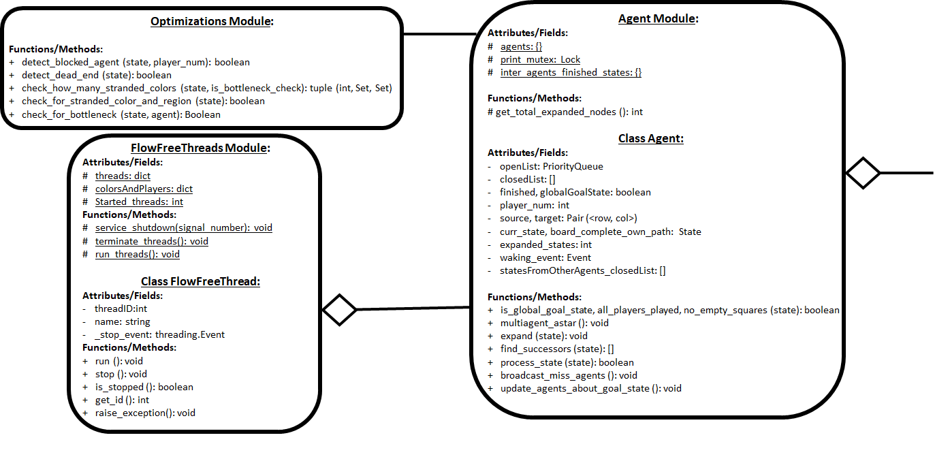
High-Level UML - Part 1
Board

Slide 23
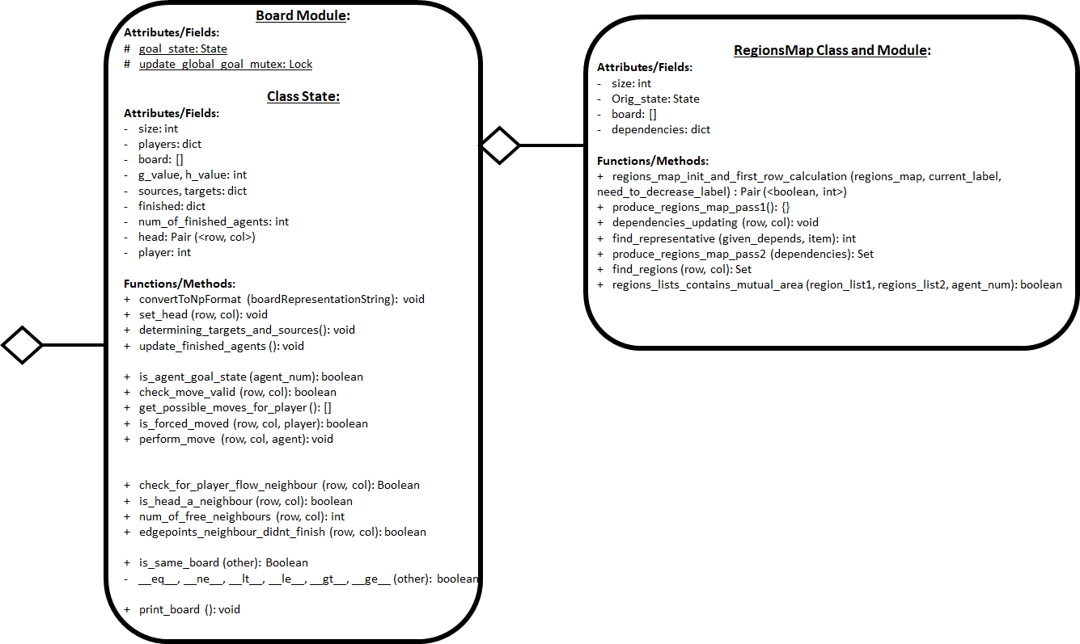
High-Level UML - Part 2
Agent

Slide 24

FlowFreeThreads Module
Global:
Attributes/Fields-
Threads container
Map <Color, Player Number>
Started threads counter
Functions/Methods-
Starting threads
Terminating threads
Signaling the Main thread
FlowFreeThread Class:
Attributes/Fields-
Info: Name and ID
Stopping event
Functions/Methods-
Run
Stop
Get Info
Raise Exception

Slide 25

Agent Module
Global:
Attributes/Fields-
Agents container
Print Mutex
Shared-Resource: bulletin board- where every Agent can post relevant States for the other Agents
Functions/Methods-
Summarizing
Agent Class:
Attributes/Fields-
Lists: OpenList & ClosedList, statesFromOtherAgents
Edgepoints: Source & Target
Relevant Boards: current, last completed
Info: ID number, #expanded nodes
Finish Flags: Local & Global
Waking Event
Functions/Methods-
Recognizing global Goal-State
Multiagent A* interface ( Multiagent A*, Expand, Find Successors)
State Processing
Communication with the other Agents

Slide 26
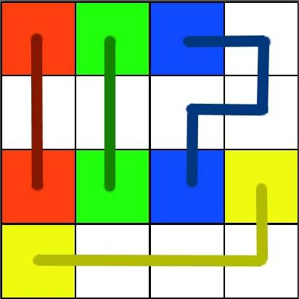
Board Module
Global:
Attributes/Fields-
Global Goal-State and it’s Mutex
State Class:
Attributes/Fields-
General Info: size, mapping <Color, Player Number>, finished Agents tracking, Sources & Targets
Values: g & h
Player: Number, Head, current Board
Regions Map
Functions/Methods-
Formalizing the puzzle as a Search Problem
Initialization: Setting the Head, Determining the Sources and the Targets
Recognizing local Goal-State
Move: Validation, Performing, Options, Forced checking
Neighbours: #Free neighbours, Recognizing a Flow’s Head as a neighbour, Neighbours that are edge points of incompleted Agents, Make sure that there is a neighbour of the current Flow
Comparable Interface
Help Methods: Print, Indices Converting, Test, Manhatten Dist. Heur., #Empty tiles
Keep track of the number of finished Agents

Slide 27
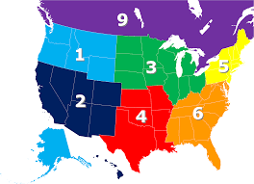
RegionsMap Module
RegionsMap Class:
Attributes/Fields-
Ancestor Info: size, board and instance
Dependencies List
Functions/Methods-
First Row Calculation (looking only Left)
Pass 1 & Pass 2 (Connected Component Labeling algorithm)
Dependencies Manipulations
Regions Manipulations

Slide 28
04
Optimizations
Dead-ends Detection, Stranded Colors and Regions, Chokepoints Detection, Fast-forwarding

Slide 29
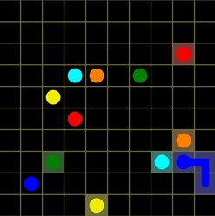
Forced-Moves consideration
A move is considered to be forced if a flow has only one single possible square to move into.
OR
An empty square is adjacent to only one single flow’s head and it has only one free neighbor
(like the Orange agent in the picture)
Taken from: https://mzucker.github.io/2016/08/28/flow-solver.html

Slide 30
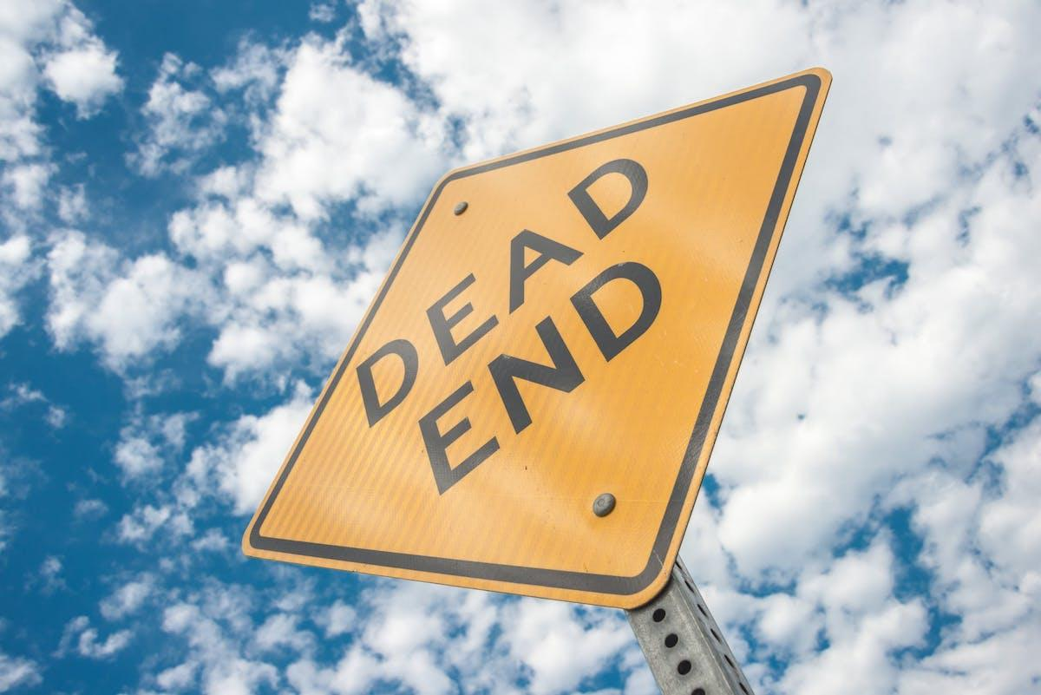
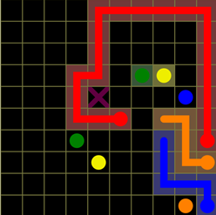
Dead-ends Detection
A square that has a way into it but there is no way out of it (like the X square in the picture).
A state contains a dead-end like this is unsolvable and should be eliminated in order to reduce the branching factor.
Taken from: https://mzucker.github.io/2016/08/28/flow-solver.html

Slide 31
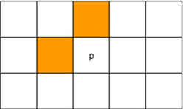
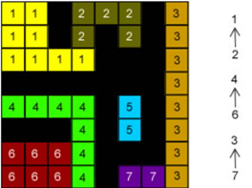
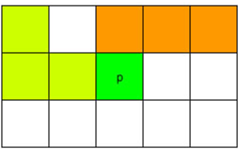
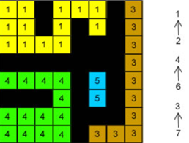
Connected Component Labeling Algorithm
First Pass:
We’ll look at the up neighbor and the left neighbor of each square
- In case of conflict, we’ll generate a dependency (For example 2->1)
Finally
Second Pass: Unification of regions considering dependencies-
Taken from: http://aishack.in/tutorials/connected-component-labelling/

Slide 32
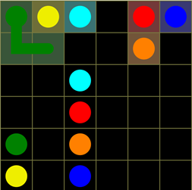
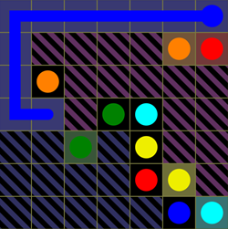
Stranded-Colors
Blocking a source/target of other agent.
(Like Green blocks Yellow)
For each non-completed color, there must be a region contains both the current position (head/source) as well as it’s target.
Taken from: https://mzucker.github.io/2016/08/28/flow-solver.html

Slide 33
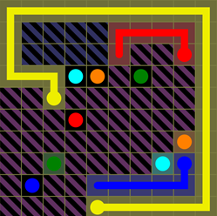
Stranded-Regions
For each region, there must be at least one contained color whose current position (head/source) and target are located at the same region.
Taken from: https://mzucker.github.io/2016/08/28/flow-solver.html

Slide 34
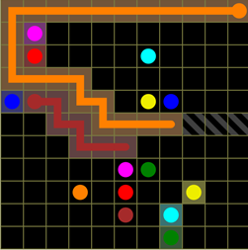
Chokepoint Detection
A bottleneck of width n can’t enable flow of more than n colors. This is an unsolvable situation.
Taken from: https://mzucker.github.io/2016/08/28/flow-solver.html

Slide 35
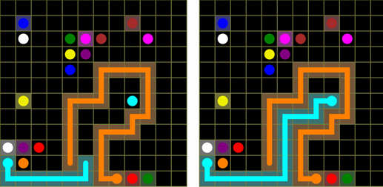
Fast-Forwarding
Speeding up the expansion of Forced-Moves every time
that there is such a move.
Taken from: https://mzucker.github.io/2016/08/28/flow-solver.html

Slide 36
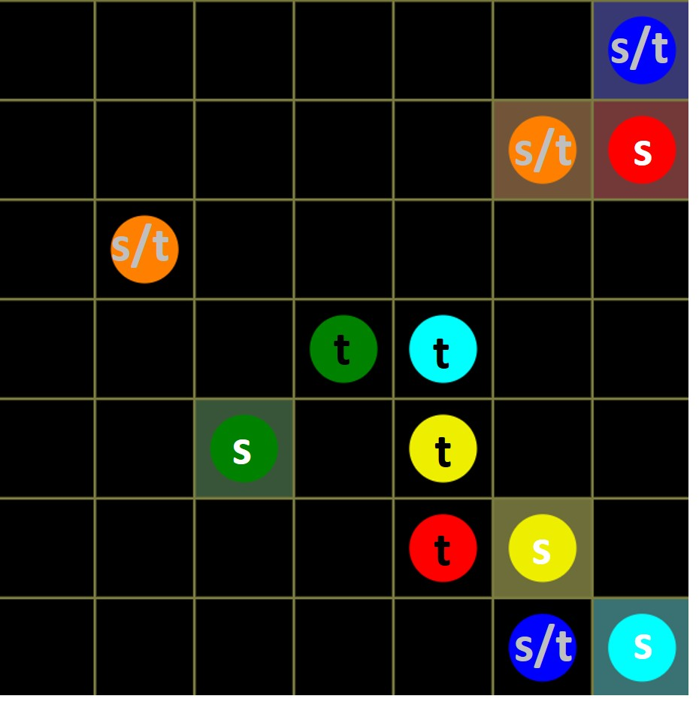
Source/Target Determining
Rule of Thumb: We would prefer the source to be closer to the outer boundary than the target.
s = Necessarily source
t = Necessarily target
s/t = can be source or target
Taken from: https://mzucker.github.io/2016/08/28/flow-solver.html

Slide 37
05
Observations
Experimental Measurements, Findings

Slide 38
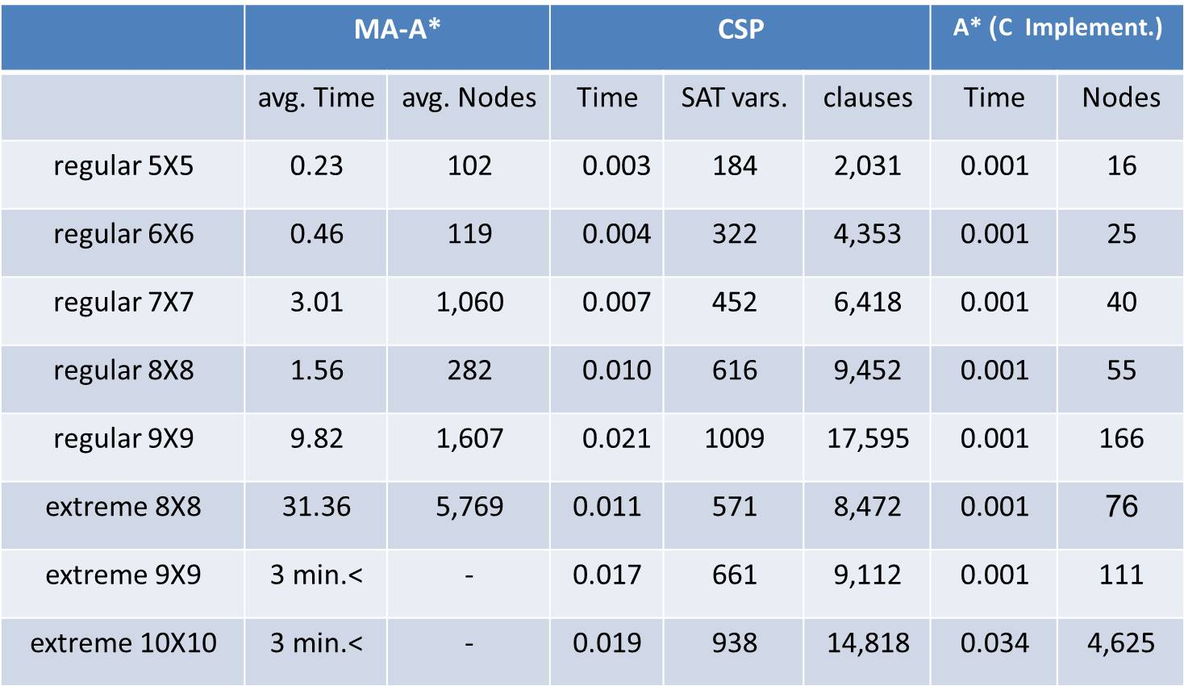
Experimental Measurements
Notes: 1)The avg. values of MA-A* were taken regarding the mean of 5 measurements 2)The times are in sec.
3) Processor: Intel(R) Core(TM) i5-5200 CPU @ 2.20 GHz 2.19GHz

Slide 39
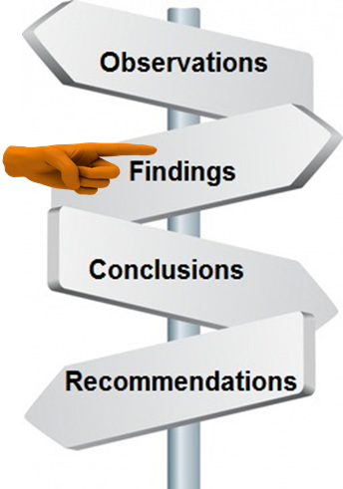
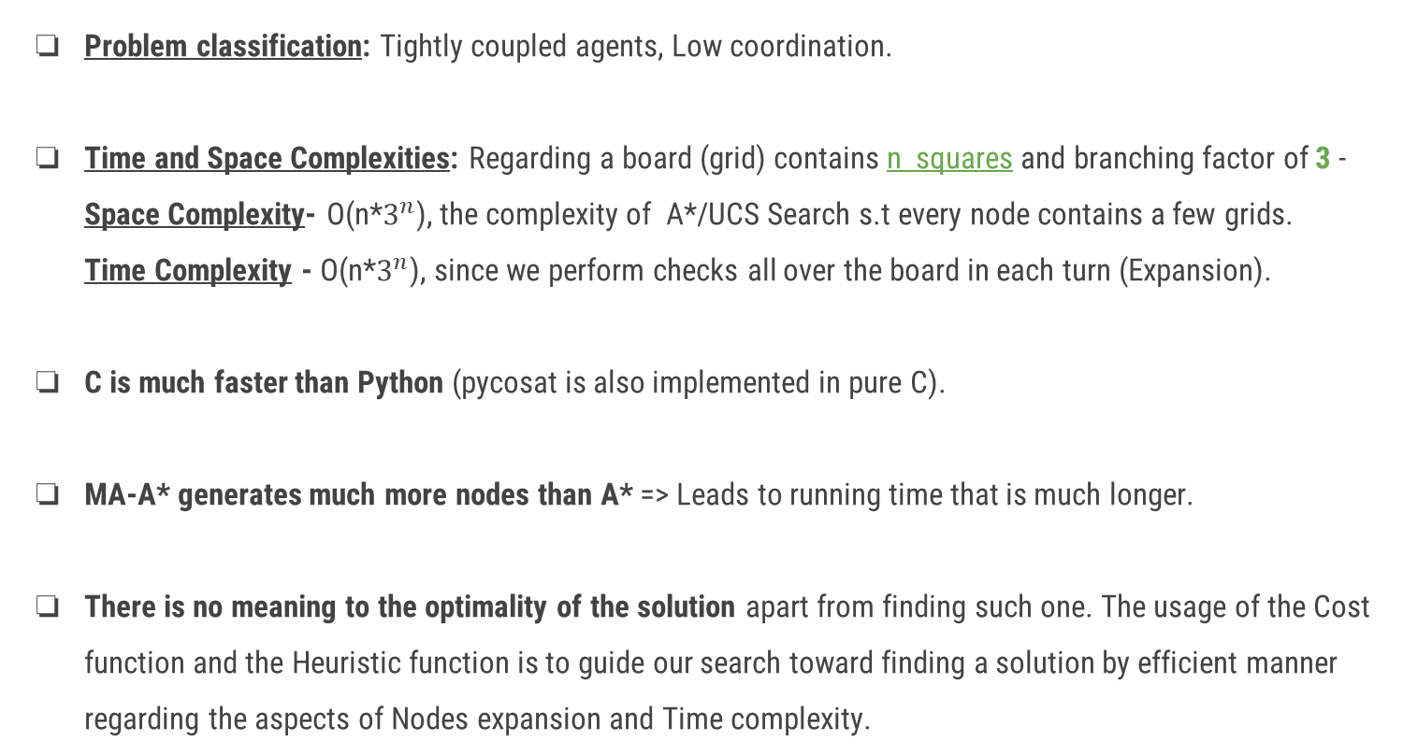
Findings
Problem classification: Tightly coupled agents, Low coordination.
Time and Space Complexities: Regarding a board (grid) contains n squares and branching factor of 3 -
Space Complexity- O(n*$3^{n}$), the complexity of A*/UCS Search s.t every node contains a few grids.
Time Complexity - O(n*$3^{n}$), since we perform checks all over the board in each turn (Expansion).
C is much faster than Python (pycosat is also implemented in pure C).
MA-A* generates much more nodes than A* => Leads to running time that is much longer.
There is no meaning to the optimality of the solution apart from finding such one. The usage of the Cost function and the Heuristic function is to guide our search toward finding a solution by efficient manner regarding the aspects of Nodes expansion and Time complexity.
Notes:
I prefered relating to the parameter n as mentioned above rather than as d=depth of cheapest solution, in order to consider the characteristic of our specific problem regarding our specific code (that includes the checks all over the board in each expansion).

Slide 40
06
Conclusions

Slide 41

Conclusions
Regarding the platform of Flow Free and our algorithm, an addition of agent/s (color/s) to a given puzzle increases the run time complexity only by a polynomial rate as opposed to the grid size increasing which results in exponential growth of the time complexity.
CSP is more effective than A* Search in case that the branching factor is greater than 2 and the number of CSP variables asymptotically equals to the max depth of the search tree.
There are duplicated local calculations in the MA-A* (Although avoiding duplicated global
calculations like 1->2->3 which is similar to 1->3->2/2->1->3/2->3->1 / 3->1->2/ 3->2->1).
Splitting the closedList to local part and global part may reduce the running time for some cases.
Notes:
I prefered relating to the parameter n as mentioned above rather than as d=depth of cheapest solution, in order to consider the characteristic of our specific problem regarding our specific code (that includes the checks all over the board in each expansion).

Slide 42
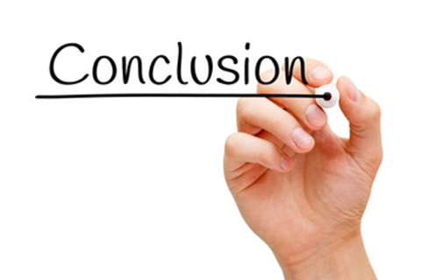
Conclusions (More trivial ones)
Using parallelism doesn’t necessarily reduces the running time (since there is an issue of access to shared resources and maybe duplicated calculations).
There are problems which have to be solved by centralized manner in their nature.
The Hardware (Processor, Cores) has a significant influence on the performance.
Future work: To check whether based graphplan heuristics improve the performance
(since they are more accurate) although it will take more time to calculate them.

Slide 43
07
References

Slide 44
References
[1] Multi-Agent A* for Parallel and Distributed Systems - Raz Nissim and Ronen Brafman
[2] From One to Many: Planning for Loosely Coupled Multi-Agent Systems - Ronen I. Brafman and Carmel Domshlak
[3] A General, Fully Distributed Multi-agent Planning Algorithm - Raz Nissim, Ronen I. Brafman and Carmel Domshlak
[4] Meta-Agent Conflict-Based Search For Optimal Multi-Agent Path Finding - Guni Sharon,
Roni Stern, Ariel Felner and Nathan Sturtevant
[5] ICBS: Improved Conflict-Based Search Algorithm For Multi-Agent Pathfinding - Eli Boyarski, Guni Sharon, Roni Stern, Ariel Felner, David Tolpin, Oded Betzalel and Eyal Shimony

Slide 45

Q & A

Slide 46
Thanks You!

